Slide 1
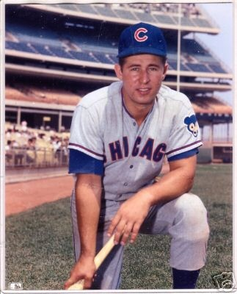
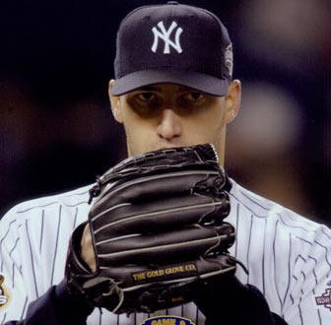
Should Ron Santo and Andy Pettitte be inducted in the Hall of Fame?
By Drew Meek and Will Seidel

Slide 2
Why These Players
We chose Pettitte and Santo because neither are, at this time, in the Hall of Fame for different reasons.
Ron Santo’s eligibility has expired several years ago while many, including leading sabermatrician Bill James, have said he was unfairly overlooked by the BBWAA.
Andy Pettitte has just now retired playing his last season in 2010 and will not be eligible for election until 2016. His Hall of Fame qualifications are currently being debated.

Slide 3
Ron Santo
Ron Santo was a third baseman for the Chicago Cubs from 1960-73, and played his final season in 1974 with the Chicago White Sox.
Santo won 5 gold gloves, was an all-star 9 times, and was 4 times in the top 10 in MVP voting.
Santo did not reach major milestones such as 500 homeruns or 3000 hits that almost always automatically qualify a player for the Hall of Fame.

Slide 4
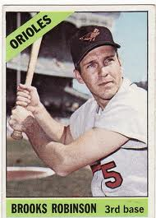
Santo vs. Hall of Fame Third Basemen
We decided to compare Ron Santo to the 10 third basemen already in the Hall in 6 statistical categories.
Frank Baker, 1908-22
Wade Boggs, 1982-99
George Brett, 1973-93
Jimmy Collins, 1885-1908
George Kell, 1943-57
Freddie Lindstrom, 1924-36
Eddie Mathews, 1952-68
Brooks Robinson, 1955-77
Mike Schmidt, 1972-89
Pie Traynor, 1920-37

Slide 5
Batting Average
Santo: .277
Mean: .29573
Maximum: .328
3rd Quartile: .311
Median: .305
1st Quartile: .271
Minimum: .267
Santo does not have the highest career batting average, but he does beat Robinson, Mathews, and Schmidt.

Slide 6
OBP
Santo: .362
Mean: .36455
Maximum: .415
3rd Quartile: .367
Median: .363
1st Quartile: .351
Minimum: .322
Santo’s career on base percentage is very close to both the mean and median of current Hall of Famers.

Slide 7
SLG
Santo: .464
Mean: . 4527
Maximum: .527
3rd Quartile: .487
Median: .443
1st Quartile: .414
Minimum: .401
Santo is this time in the top half of 3rd basemen in Cooperstown. He beats both the mean and median in SLG.

Slide 8
OPS
Santo: .826
Mean: .8175
Maximum: .908
3rd Quartile: .858
Median: .805
1st Quartile: .781
Minimum: .723
Santo is again in the top half of hall of famers. And is well above the mean and median of these players.

Slide 9
HRR
We added this because many voters complain that Santo did not reach milestones such as 500 HR or 300 hits. However, his career was not very long compared to the other third basemen in the hall, yet he is 3rd among these players in total home runs as well as home runs per at-bat, behind only Eddie Mathews and Brooks Robinson who both had long careers and, along with Alex Rodriguez, are the only third basemen in the 500 HR club.
Santo: .826
Mean: .8175
Maximum: .908
3rd Quartile: .858
Median: .805
1st Quartile: .781
Minimum: .723

Slide 10
Runs Created
Runs Created(RC)
RC= ((H+BB)*TB)/(AB+BB)
Santo: 1373
Mean: 1326
Maximum: 1873
3rd Quartile: 1677
Median: 1279
1st Quartile: 944
Minimum: 882
Santo is again clearly among the elite 3rd basemen in Runs Created.

Slide 11
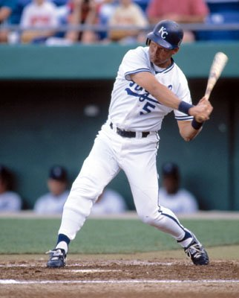
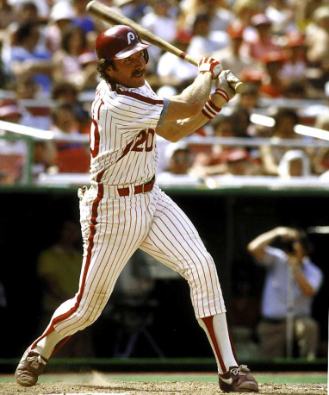
Santo against Elite Hall of Famers
Since the argument can be made that some of these players played during eras in which offensive numbers were often very low, we decided to compare Santo’s stats to just the Hall of Famers who’s careers overlapped with Santo. These were George Brett, Eddie Mathews, Brooks Robinson and Mike Schmidt. We took the average of those four players to compare them to Santo.

Slide 12
Against Elite Hall of Famers
BA
Average: .278
Santo: .277
OBP
Average: .362
Santo: .362
SLG
Average: .481
Santo: .464
OPS
Average: .843
Santo: .826
HRR
Average: .045
Santo: .042
RC
Average: 1639
Santo: 1373

Slide 13
Andy Pettitte
Andy Pettitte played for the New York Yankees from 1995-2003 and 2007-2010, in between played for the Houston Astros from 2004-2006.
Pettitte played on 3 all-star teams and 5 World Series winning teams. He was also the MVP of the 2001 ALCS.
Similar to Santo, Pettitte did not reach major pitching plateaus such as 300 wins or 3000 strikeouts.

Slide 14
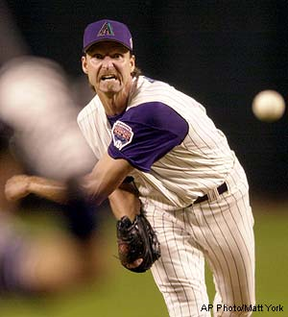
Pettitte vs Hall of Fame Pitchers
Due to the large amount of pitchers in the Hall of Fame we decided to use a selection of pitchers already in Cooperstown whose careers occurred closest to Pettitte’s as well three pitchers who played during Pettitte’s era and are widely considered to be highly qualified for the Hall of Fame.
These pitchers are:
Tom Seaver , 1967-1986
Steve Carlton, 1965-1988
Bert Blyleven, 1970-1992
Fergie Jenkins, 1965-1983
Dennis Eckersley, 1975-1998
Roger Clemens, 1984-2007
Randy Johnson, 1985-2009
Greg Maddux, 1986-2008

Slide 15
ERA
Pettitte: 3.88
Mean: 3.2250
Max: 3.5000
3rd Quartile: 3.3325
Median: 3.2550
1 st Quartile: 3.1300
Minimum: 2.8600
ERA shows Pettitte’s weakest qualification for the Hall. His ERA is well above all of these pitchers.

Slide 16
Wins
Pettitte: 240
Mean: 302.5
Max: 355.0
3rd Quartile: 347.8
Median: 307.0
1 st Quartile: 284.8
Minimum: 197.0
Pettitte had quite a large win total that is comparable to many Hall of Famers, but is not among the elite.

Slide 17
W-L%
Pettitte: .635
Mean: 0.5896
Max: 0.6580
3rd Quartile: 0.6370
Median: 0.5885
1 st Quartile: 0.5405
Minimum: 0.5340
Pettitte has a very strong win-loss percentage and is close to the top quartile of Hall of Fame pitchers.

Slide 18
Hits
Pettitte: 3185
Mean: 4094
Max: 4726
3rd Quartile: 4662
Median: 4164
1st Quartile: 3502
Minimum: 3076
Pettitte’s total number of hits is very good compared to most Hall of Famers, however many of these pitchers may have had longer careers than Pettitte.

Slide 19
WHIP
Pettitte: 1.357
Mean: 1.1695
Max: 1.2470
3rd Quartile: 1.1917
Median: 1.1660
1st Quartile: 1.1423
Minimum: 1.1210
Pettitte’s WHIP is much higher than what he would need to qualify for the Hall of Fame.

Slide 20
SO/9
Pettitte: 6.6
Mean: 7.363
Max: 10.600
3rd Quartile: 8.225
Median: 6.750
1st Quartile: 6.450
Minimum: 6.100
Pettitte’s SO/9 is not extremely high, but it does put him in the range of the Hall of Fame pitchers.

Slide 21
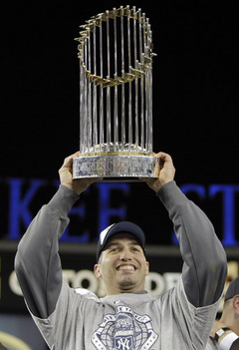
Pettitte’s Other Qualifications
Pettitte played on many very successful teams winning 5 World Series, while Santo never made a postseason appearance. Also Pettitte’s history of performance enhancing drugs may be another reason he may not receive the votes necessary to enter the Hall of Fame. Unlike Clemens, Pettitte did not deny his use which could influence voters.

Slide 22
Conclusion
From our analysis we see that Ron Santo’s numbers are close to the historical elites at his position and he should have been elected to the Hall of Fame. Pettitte is less clear and while he does have an extremely high winning percentage for his career, the rest of his numbers lag behind the elites, and he probably should not be elected.
We do recognize that the BBWAA voters have many different reasons to vote for a player or not to vote for a player such as success of the player’s team. They do not always vote for the player with the best statistical qualifications and may vote based on other factors, such as popularity, team success, or players with single particularly stong seasons.

Slide 23
Sources
baseball-reference.com
baseball-almanac.com
mlb.com

